Slide 1
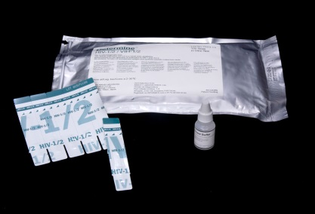
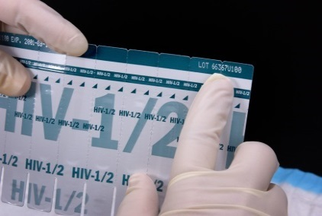
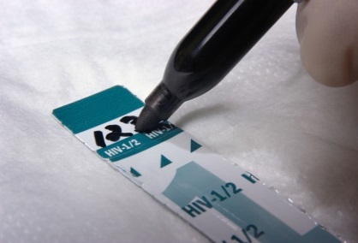
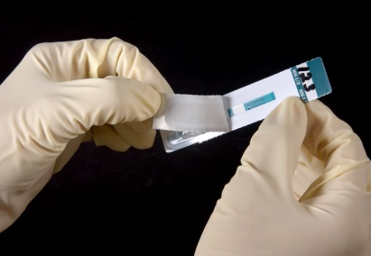
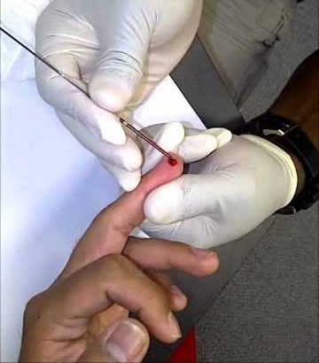
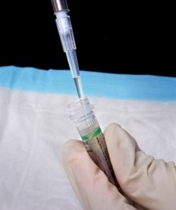
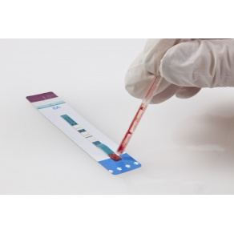
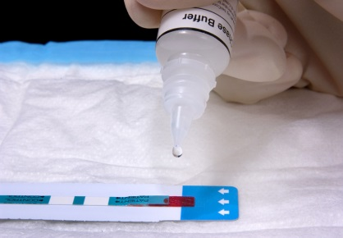
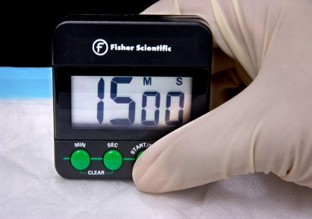
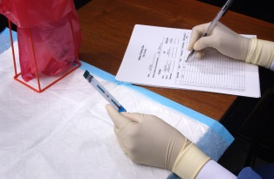
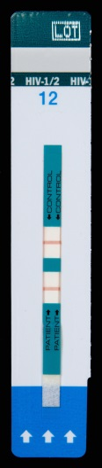
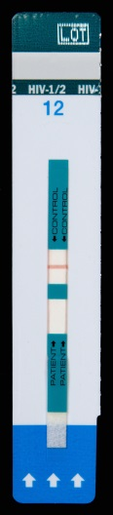

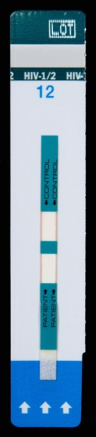
Determine HIV -1/2 Rapid Test
(For use with whole blood, serum, or plasma)
Store kit:
2 - 30° C
Check kit before use. Use only items that have not expired or been damaged.
Bring kit and previously stored specimens to room temperature prior to use.
Always use universal safety precautions when handling specimens. Keep work areas clean and organized.
This outline does not replace the product insert or your standard operating procedure (SOP).
Collect all necessary supplies.
Use 1 strip per client. Record lot # and expiry date in the register.
Label the test strip with client ID number.
Pull off the protective foil cover.
Collect 50 µl of specimen using either a capillary tube or precision pipette.
Apply the specimen to the absorbent pad on the strip.
For whole blood only add drop of chase buffer to the specimen pad.
Wait 15 minutes (no longer than 60 minutes) before reading the results.
Read and record the results and other pertinent info on the worksheet.
Reactive
2 lines of any intensity appear in both the control and patient areas.
Non-reactive
1 line appears in the control area
and no line in the patient area.
Invalid
No line appears in the control area.
Do not report invalid results. Repeat test with a new test device even if a line appears in the patient area.

Slide 2
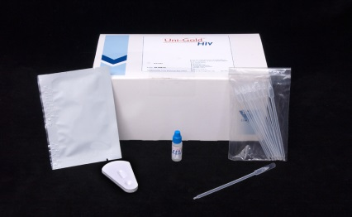
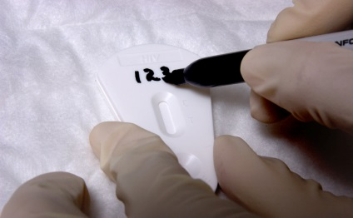
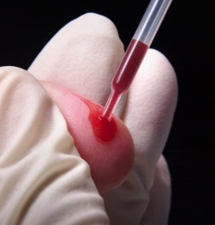
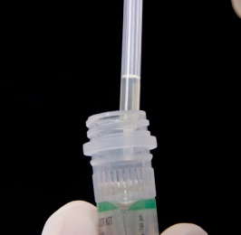
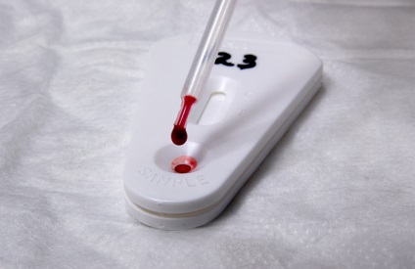
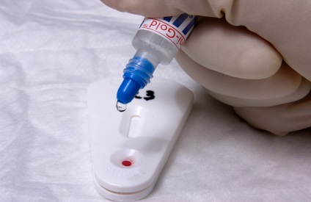
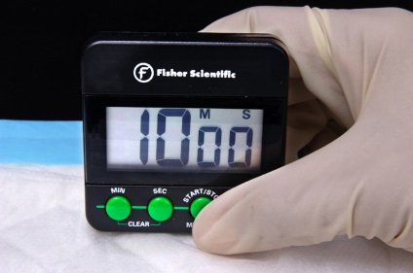
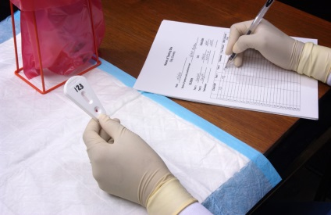
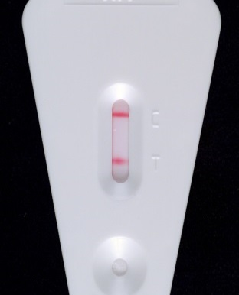
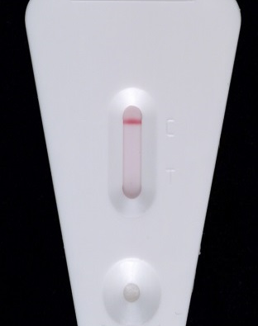
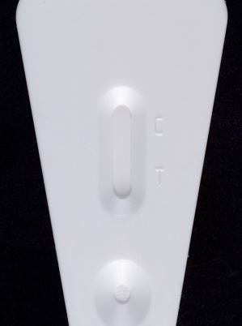
Uni-Gold HIV -1/2 Rapid Test
(For use with whole blood, serum, or plasma)
Store kit:
2 - 30° C
Check kit before use. Use only items that have not expired or been damaged.
Bring kit and previously stored specimens to room temperature prior to use.
Always use universal safety precautions when handling specimens. Keep work areas clean and organized.
This outline does not replace the product insert or your standard operating procedure (SOP).
Collect test items and other necessary lab supplies.
Remove device from package and label device with client identification number.
Collect specimen (blood or plasma or serum using the disposable pipette.
Add 2 drops (approx. 60µl) of specimen to the sample port in the device.
Add 2 drops (approx. 60µl) of the appropriate wash reagent to sample port.
Wait for 10 minutes (no longer than 20 min) before reading the results.
Read and record the results and other pertinent info on the worksheet.
Reactive
2 lines of any intensity appear in both the control and test areas.
Non-reactive
1 line appears in the control area and no line in the test area.
Invalid
No line appears in the control area. Do not report invalid results. Repeat test with a new test device even if a line appears in the test area.
C
T
C

Slide 3
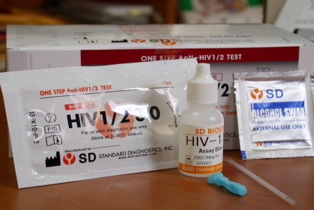
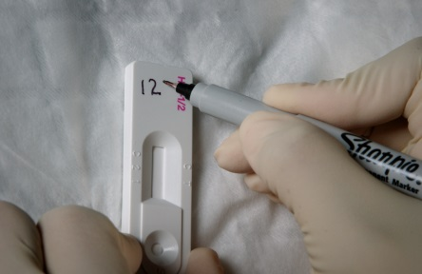

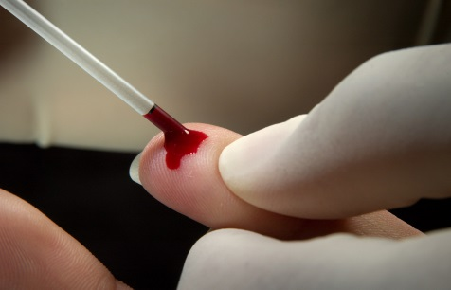
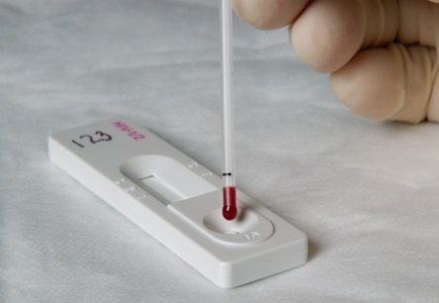
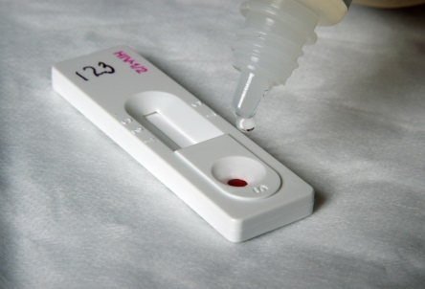
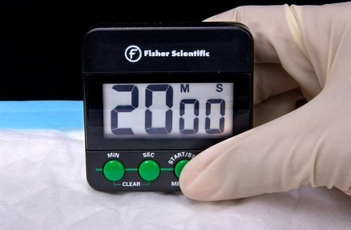
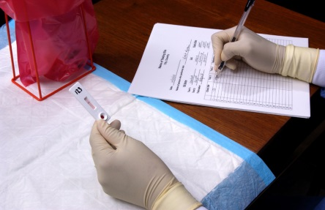
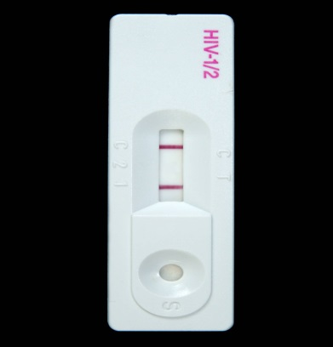
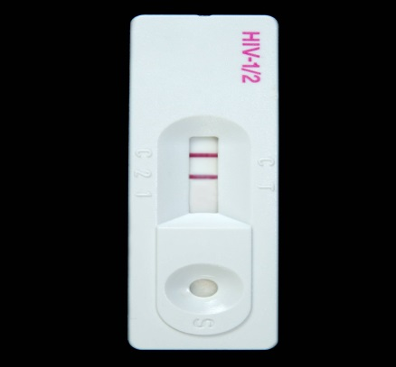
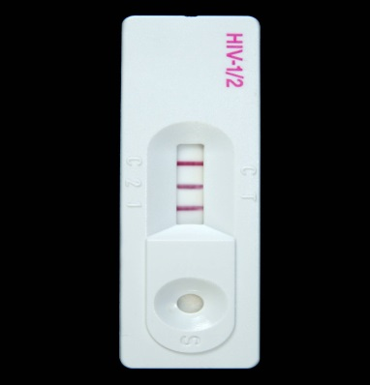
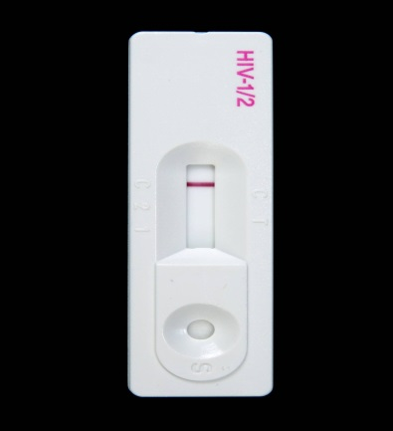
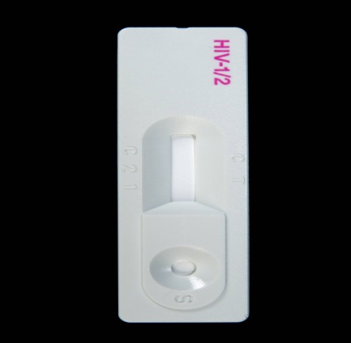
Bioline HIV -1/2 Rapid Test
(For use with whole blood, serum, or plasma)
Store kit:
1 - 30° C
Check kit before use. Use only items that have not expired or been damaged.
Bring kit and previously stored specimens to room temperature prior to use.
Always use universal safety precautions when handling specimens. Keep work areas clean and organized.
This outline does not replace the product insert or your standard operating procedure (SOP).
Collect test items and other necessary lab supplies.
Remove device from package and label device with client identification number.
Use a precision pipette to collect 10 µL of serum or plasma
Use a disposable capillary pipette to draw 20 µL of whole blood up to fill line
Apply the serum, plasma or whole blood specimen to the sample well of the test device.
Add 4 drops of the Assay diluent to the sample well.
Start timer and read the test results within 10 to 20 minutes. Don’t read test results after 20 minutes.
Read and record the results and other pertinent info on the worksheet.
HIV1 HIV 2 HIV 1/2
Reactive
Presence of 2 (“C”, “1” and “2”) or
more lines within the Result window.
Non-reactive
1 line appears in the control (“C”) area and no line in the Test area.
Invalid
No line appears in the control (“C”) area. Do not report invalid results. Repeat test with a new test device even if a line appears in the client area.

Slide 4
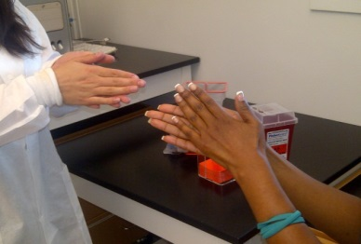
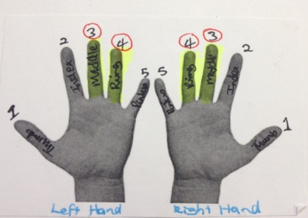
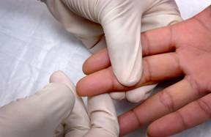
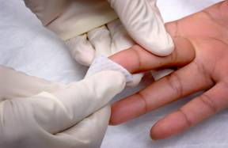
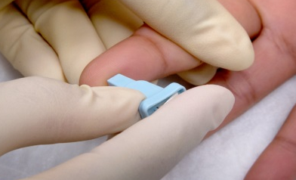

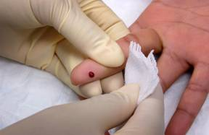
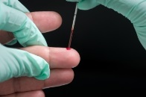
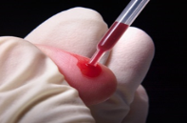
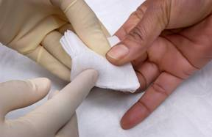
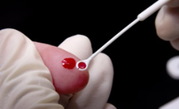
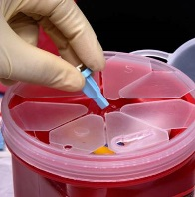
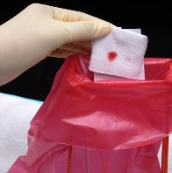
Finger Prick – JOB AID
Ask client to rub/massage
hands together. Ensure the clients hands are warm to touch.
Position hand palm-side up. Choose least calloused finger (either middle or ring finger)
Apply intermittent pressure
to help the blood flow
Disinfect fingertip. Start in the middle and work outward to avoid contamination. Allow to dry
Hold the finger and firmly place a new sterile lancet off-center on the fingertip
Firmly press the lancet
to puncture the fingertip
Wipe away the 1st drop of blood with a sterile gauze pad or cotton ball
If necessary, apply intermittent pressure on opposite side of finger for blood to flow
Apply a gauze pad or cotton ball to the puncture site until the bleeding stops
Properly dispose of all
contaminated supplies. Do not retrieve anything from the waste containers.

Slide 5
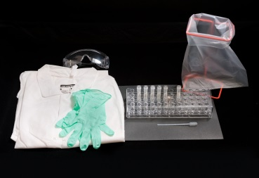
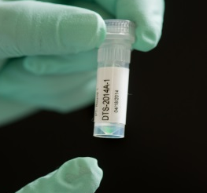







DRIED TUBE SPECIMEN (DTS) – JOB AID
Collect all necessary lab supplies.
Examine tube. Make sure
the green colored dried specimen is present and
sits at the bottom of the tube.
If not, tap the tube until the specimen is visible at the bottom.
1
2
3
4
Open the tubes only when the specimen appears at the bottom.
5
Using a disposable
pipette, add 5 drops (~200µL) of “PT buffer”
to the dried tube specimen.
6
Cap the tubes.
7
Tap the tubes to mix well.
8
Leave tubes standing
upright at room temperature
overnight.
9
The next day, tap tubes to mix and test according to testing procedures and algorithm.
Note:
Reconstitute only when you are ready to test the DTS panel the next day.
Record the results on the Results submission form and send to the reference lab.
Handout # 7.1H1

